Slide 1
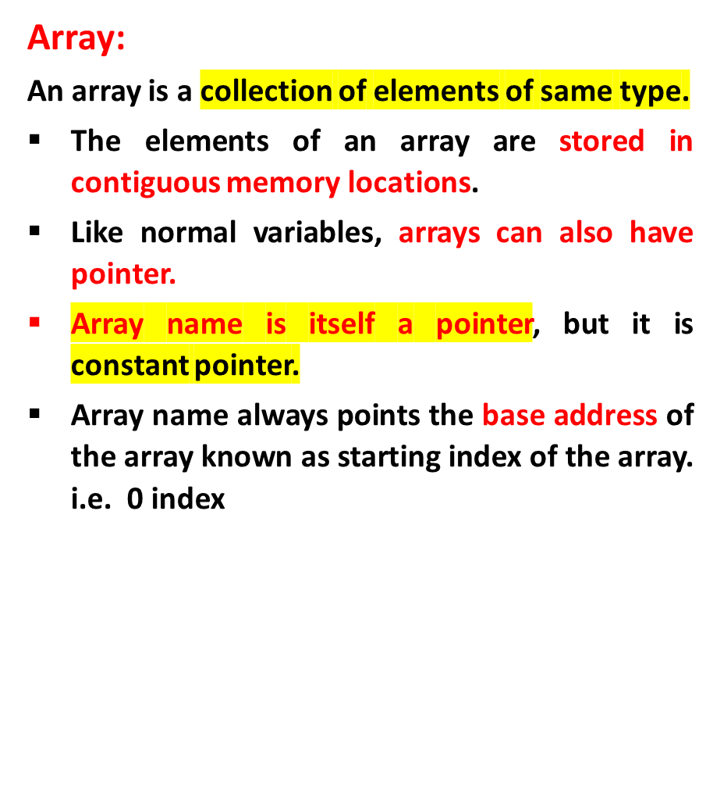
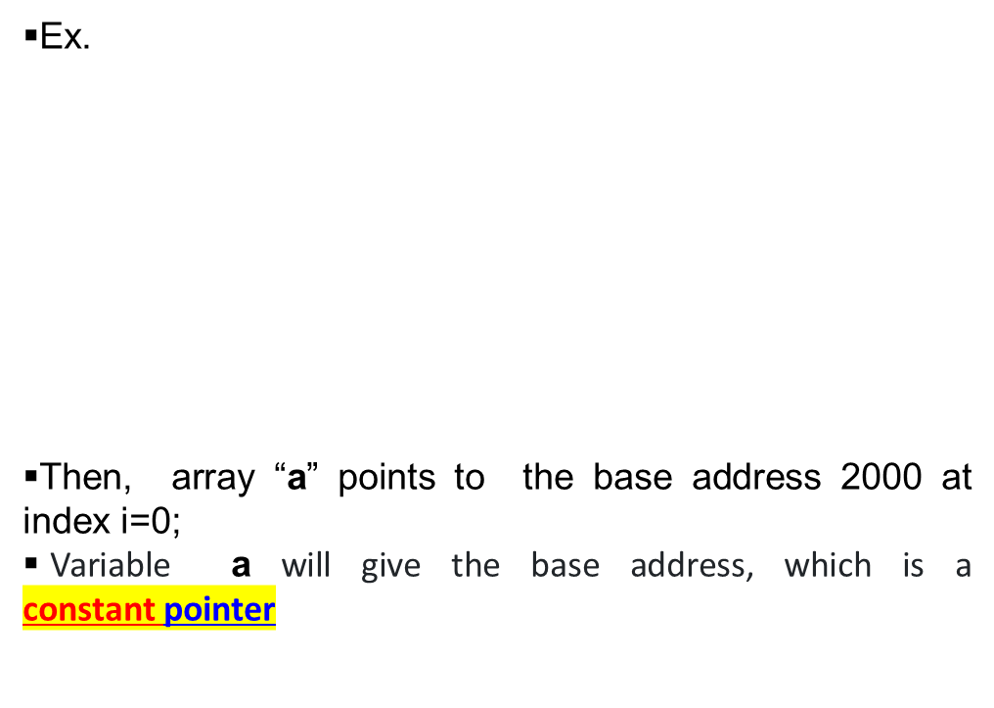
Pointer to Array
int a[5] = {10, 20, 30, 40, 50};
index i 0 1 2 3 4
address 2000 2004 2008 2012 2016

Slide 2
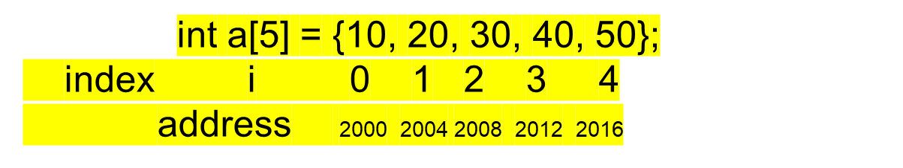
Accessing arrays using pointer
Accessing the addresses using array names:
a a+1 a+2 a+3 a+4
Array name ‘a’ is a constant pointer. It indicates the base address of the array a[0] address.
i.e &a[0]=(a+0) a[1]=(a+1) ……&a[i]=(a+i) //address of index i
Accessing the values using array addresses:
a[0]===*(a+0) ,a[1]====*(a+1) ….a[i]=====*(a+i) //value at index i

Slide 3
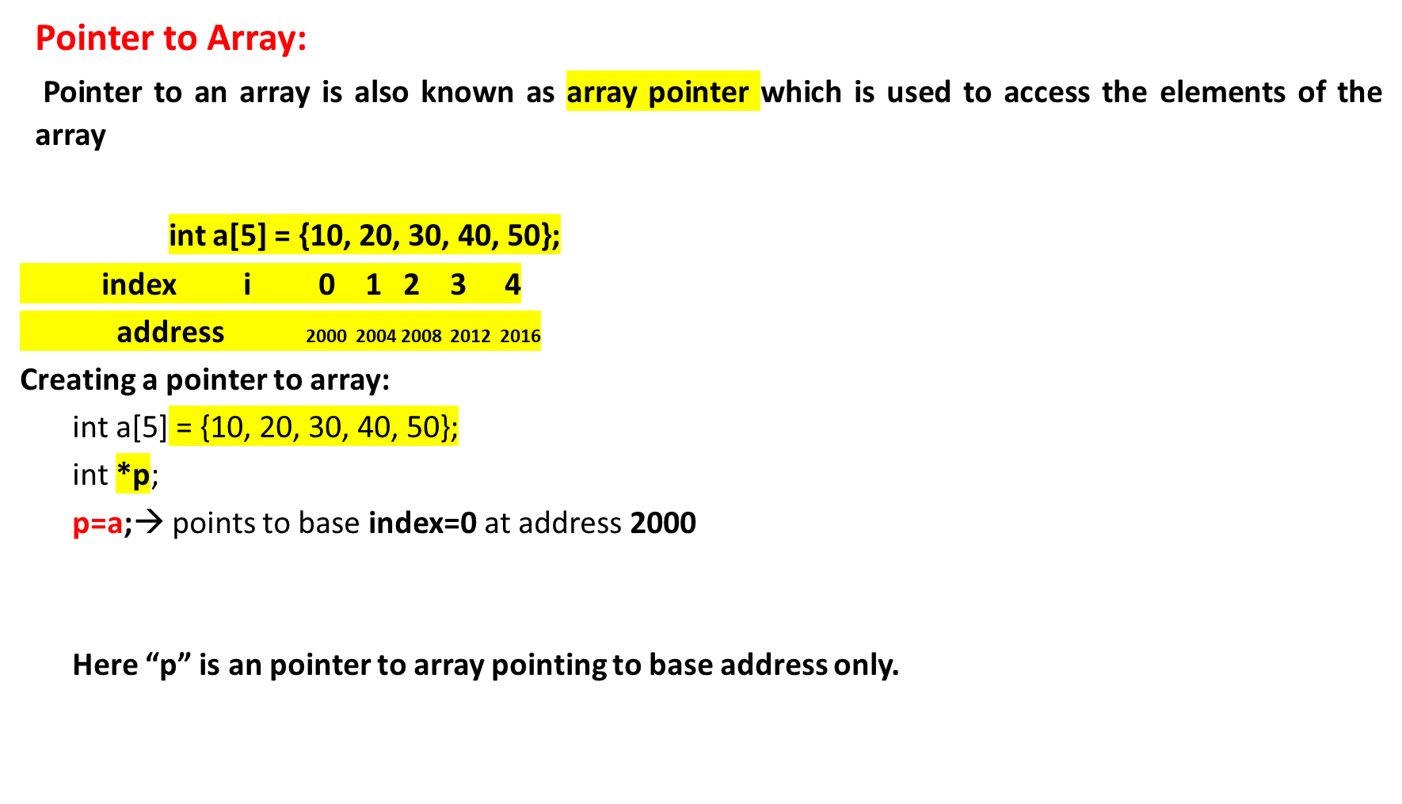
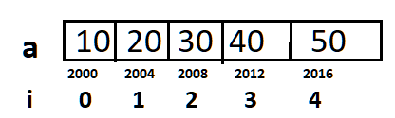
Accessing arrays using pointer

Slide 4

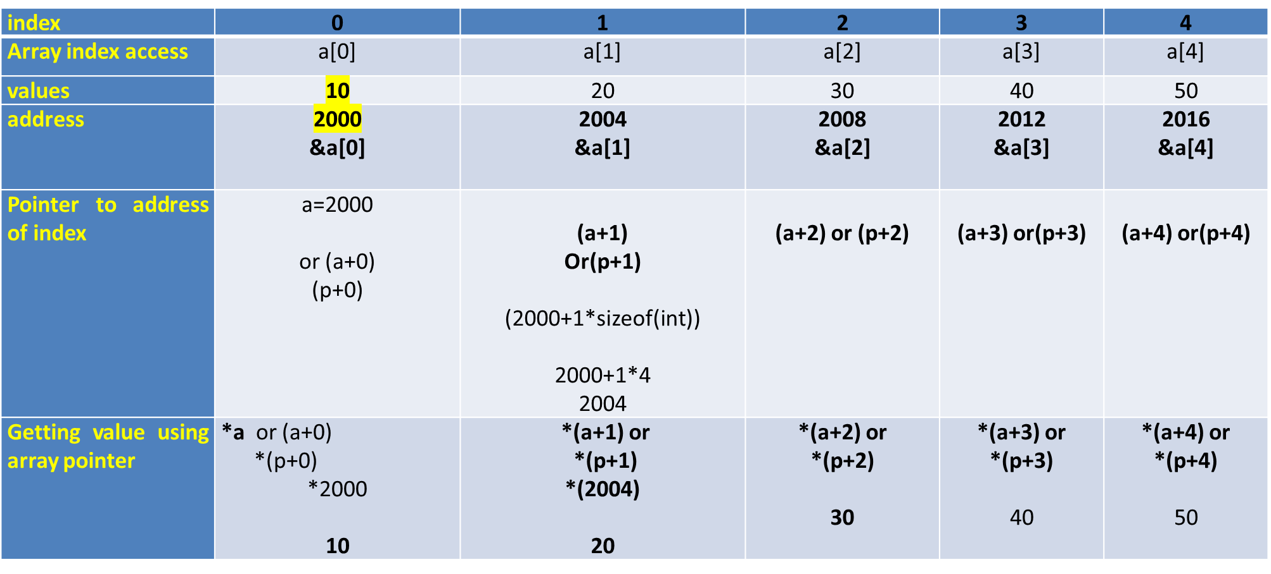
Pointers and Arrays

Slide 5
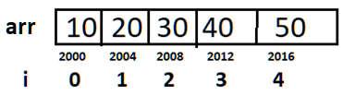
      INPUT:
      int arr[5] = {10,20,30,40,50};
      Output:
      Poiner address is 2000
      Value at pointer is 10
LOGIC:
Create an array.
2. ptr=a;
3. Print ptr //Prints 2000
4. Print *ptr ////Prints 10

Slide 6
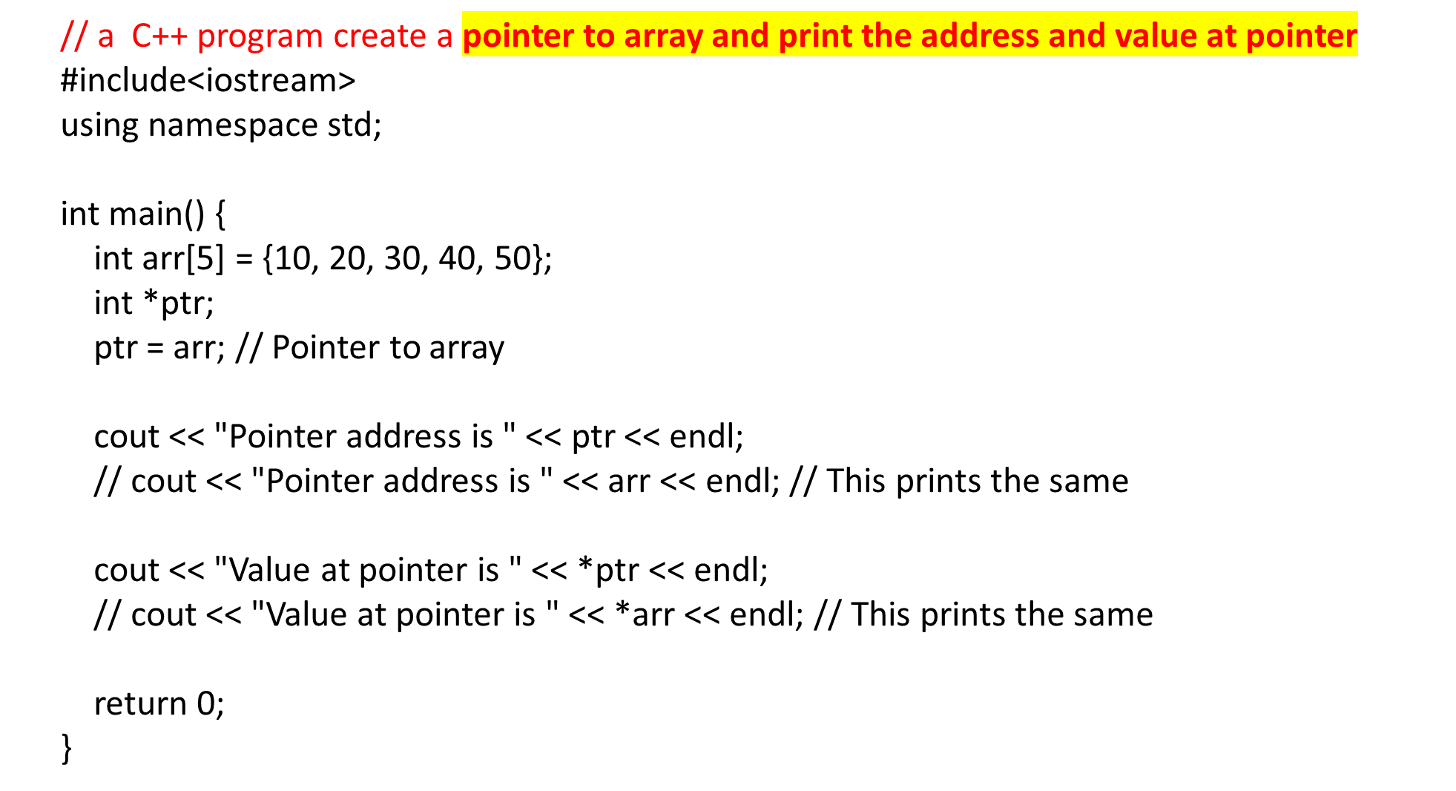
ptr=2000
Prints 2000
Prints 10

Slide 7
  Q) Write a C++ program for Reading and Printing an array elements using Pointers
Enter the size of array
4
enter array elemnts
10
20
30
40
the array elements are
10
20
30
40
LOGIC:
Create an array a[ ]
2. Create a pointer to the array a *ptr
ptr=a;
3. Read the size of array
4. Read the elements of array using pointer
    for(i=0;i<n;i++)
    cin>>ptr+I;
5. Print the elements of array using pointer
    for(i=0;i<n;i++)
    cout<<*(ptr+i));

Slide 8
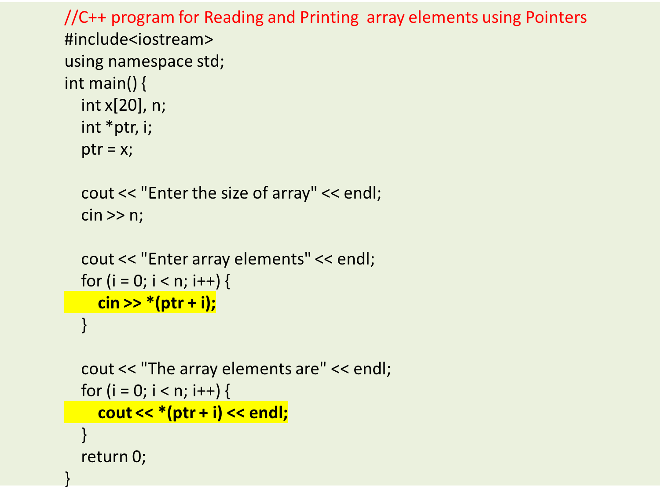

Slide 9
Q). What will be the output of the following C++ code?
#include<iostream>
using namespace std;
int main()
{
int a[3] = {1, 2, 3};
int *p = a;
cout << p << "\t" << a << endl;
return 0;
}
a) Same address is printed
b) Different address is printed
c) Compile time error
d) Nothing

Slide 10
Q). What will be the output of the following C++ code?
#include<iostream>
using namespace std;
int main()
{
int a[3] = {1, 2, 3};
int *p = a;
cout << p << "\t" << a << endl;
return 0;
}
a) Same address is printed
b) Different address is printed
c) Compile time error
d) Nothing

Slide 11
Q). What will be the output of the following C++ code?
#include<iostream>
using namespace std;
int main()
{
int ary[4] = {1, 2, 3, 4};
int *p = ary + 3;
cout << p[-2] << endl;
return 0;
}
a) 1
b) 2
c) Compile time error
d) Some garbage value

Slide 12
Q). What will be the output of the following C++ code?
#include<iostream>
using namespace std;
int main()
{
int ary[4] = {1, 2, 3, 4};
int *p = ary + 3;
cout << p[-2] << endl;
return 0;
}
a) 1
b) 2
c) Compile time error
d) Some garbage value

Slide 13
Scenario:
John is a software engineer working on optimizing code for a small game engine. In one part of the game code, there's an array of integers that represents the player's health points in different levels of the game. The team has decided that they want to double the health points for each level to make the game more challenging.
Question:
Imagine you are John, the software engineer. You have been assigned the task of doubling the health points for each level of the game by manipulating the array of integers using pointers in a C program. Here's your task:
Write a C program to double the value of each element in the array using pointers. Assume you have an array called healthPoints that contains the initial health points for each level, and it looks like thi
Input:
The input array healthPoints contains the initial health points for each level:
int healthPoints[] = {100, 120, 150, 80, 200};
Expected Output:
When you run the program, it will double the values in the healthPoints array and print both the original and updated health points:
Original Health Points: 100 120 150 80 200
Updated Health Points: 200 240 300 160 400

Slide 14
#include <stdio.h>
int main() {
int healthPoints[] = {100, 120, 150, 80, 200};
int length = sizeof(healthPoints) / sizeof(healthPoints[0]);
printf("Original Health Points: ");
for (int i = 0; i < length; i++) {
printf("%d ", healthPoints[i]);
}
printf("\n");
int *ptr = healthPoints; // Initialize a pointer to the first element of the array
// Double the values of the elements using a loop and pointers
for (int i = 0; i < length; i++) {
*ptr = (*ptr) * 2; // Double the value at the current pointer location
ptr++; // Move the pointer to the next element
}
printf("Updated Health Points: ");
for (int i = 0; i < length; i++) {
printf("%d ", healthPoints[i]);
}
printf("\n");
return 0;
}

Slide 15
Scenario:
Sarah is a programmer working on a weather monitoring application. She has an array that contains the temperatures recorded for the past five days in Celsius. Sarah wants to convert these temperatures to Fahrenheit and store them in a new array using pointers.
Question:
You are Sarah, the programmer, and you need to accomplish this task. Here's your task:
Write a C program to convert the temperatures from Celsius to Fahrenheit using pointers. You have an array called celsiusTemperatures that contains the temperatures for the past five days:
Input:
The input array celsiusTemperatures contains the temperatures in Celsius:
double celsiusTemperatures[] = {23.5, 18.2, 30.0, 15.7, 27.3};
Expected Output:
When you run the program, it should calculate the temperatures in Fahrenheit and store them in the fahrenheitTemperatures array. Here's the expected output:
Celsius Temperatures: 23.5 18.2 30.0 15.7 27.3
Fahrenheit Temperatures: 74.3 64.76 86.0 60.26 81.14

Slide 16
#include <stdio.h>
int main() {
double celsiusTemperatures[] = {23.5, 18.2, 30.0, 15.7, 27.3};
int length = sizeof(celsiusTemperatures) / sizeof(celsiusTemperatures[0]);
printf("Celsius Temperatures: ");
for (int i = 0; i < length; i++) {
printf("%.2f ", celsiusTemperatures[i]);
}
printf("\n");
// Create an array to store the Fahrenheit temperatures
double fahrenheitTemperatures[length];
double *celsiusPtr = celsiusTemperatures;
double *fahrenheitPtr = fahrenheitTemperatures;
// Convert Celsius to Fahrenheit using pointers
for (int i = 0; i < length; i++) {
*fahrenheitPtr = (*celsiusPtr * 9.0 / 5.0) + 32.0;
celsiusPtr++;
fahrenheitPtr++;
}
printf("Fahrenheit Temperatures: ");
for (int i = 0; i < length; i++) {
printf("%.2f ", fahrenheitTemperatures[i]);
}
printf("\n");
return 0;
}

Slide 17
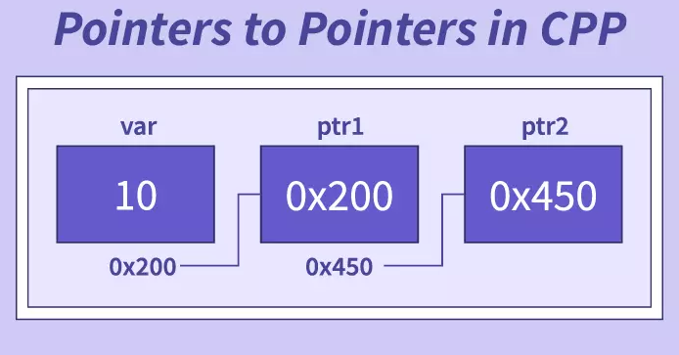
Pointer to Pointer(double pointer):**
*→single pointer(pointer)
** →double pointer(pointer to pointer)
A pointer to pointer holds the address of pointer of same type is known as pointer-to-pointer or double pointer.
Declaration of a Pointer to Pointer
Syantax:
datatype **ptrtoptr;
int **q ;
Here q is a pointer to pointer. There must be two *’s in the declaration of pointer to pointer.
Ex:
int a = 10, *p, **q;
//p is pointer, q is pointer to pointer
Initialization of pointer to pointer:
ptrtoptr_var=&ptr_var;
p = &a; //pointer initialization consider
address of a=1000
q=&p ;
// Pointer to pointer initialization
consider address of p=2000

Slide 18
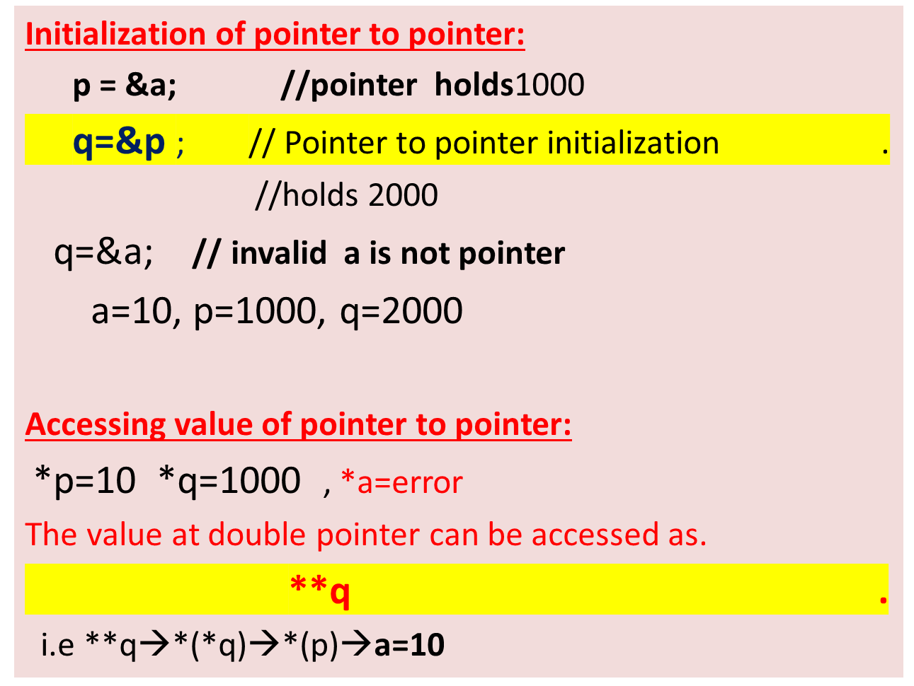
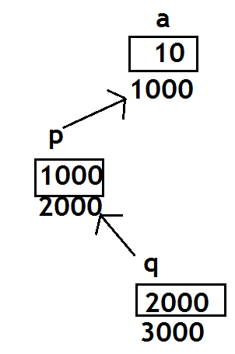
Pointer to Pointer(double pointer):**
(p is a pointer)
(q is a Double pointer)

Slide 19
Q) Write a C++ program to create a pointer to pointer(double pointer)
INPUT:
Enter a
789
OUTPUT:
Value of a = 789
Value of a using single pointer = 789
Value of a using double pointer = 789

Slide 20
Pointer to Pointer(double pointer):**
// C++ program to create a pointer to pointer(double pointer)
#include <stdio.h>
int main()
{
int a , *p, **q;
printf(“Enter a\n”);
scanf(“%d”,&a);
p = &a; //initializing pointer
q = &p; //initializing ptr to ptr
printf("Value of a= %d\n", a );
printf("Value of a using single pointer = %d\n", *p);
printf("Value of a using pointer to pointer = %d\n", **q);
return 0;
}

Slide 21
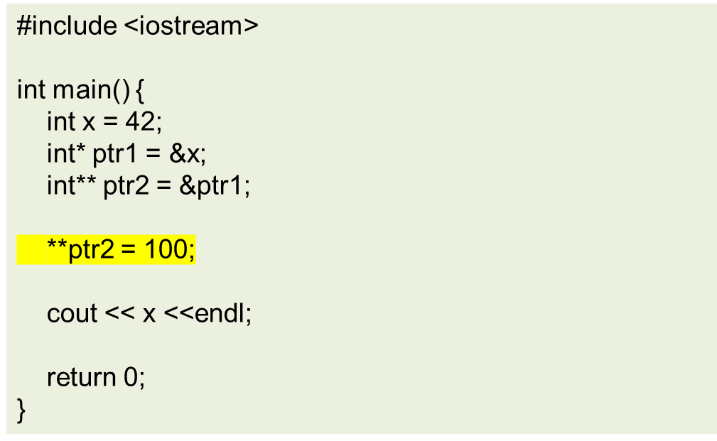
Q) What will be the output of the below code?
a. 42
b. 100
c. Compilation error
d. Runtime error

Slide 22
Q) What will be the output of the below code?
Explanation:
In the code, ptr1 is a pointer to an integer x, and ptr2 is a double pointer (pointer to a pointer) that points to ptr1.
When **ptr2 is used to modify the value pointed to by ptr1, it indirectly modifies the value of x, setting it to 100.
Therefore, the output of the code will be 100.
a. 42
b. 100
c. Compilation error
d. Runtime error

Slide 23
Q) What will be the output of the below code?
#include <iostream>
int main() {
int a = 42;
int b = 87;
int* ptr1 = &a;
int* ptr2 = &b;
int** ptr_double = &ptr1;
*ptr_double = ptr2;
cout << **ptr_double << endl;
return 0;
}
a. 42
b. 87
c. Compilation error
d. Runtime error

Slide 24
Q) What will be the output of the below code?
#include <iostream>
int main() {
int a = 42;
int b = 87;
int* ptr1 = &a;
int* ptr2 = &b;
int** ptr_double = &ptr1;
*ptr_double = ptr2;
cout << **ptr_double << endl;
return 0;
}
Explanation:
In the code, initially, ptr1 points to the integer a, and ptr2 points to the integer b.
Then, the double pointer ptr_double is set to point to ptr1. However, the line *ptr_double = ptr2; changes the target of ptr_double to point to ptr2, effectively making it point to b.
Therefore, when **ptr_double is used to access the value, it retrieves the value of b, which is 87.
a. 42
b. 87
c. Compilation error
d. Runtime error

